Slide 1
Rootless
Streamlined visa support for travelers worldwide
Group 8

Slide 2
What is Rootless?
A mobile app that turns immigration research into a personalized action plan
Enter your passport, destination, and relocation goal and Rootless handles the rest
Filters and ranks visa options, then builds a step by step checklist with deadlines based on your arrival date
Visa Life Planner sends alerts when life changes like a new job or marriage affect your status
A guided relocation workflow from research to residency, not just a visa lookup tool

Slide 3
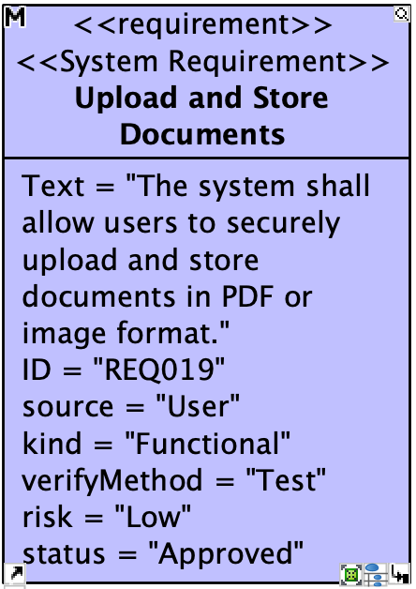
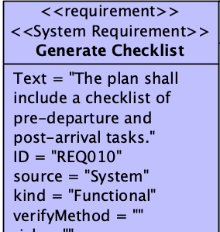
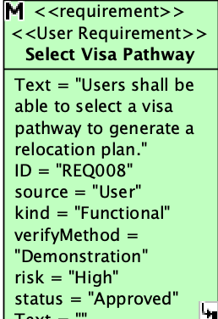
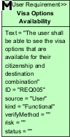
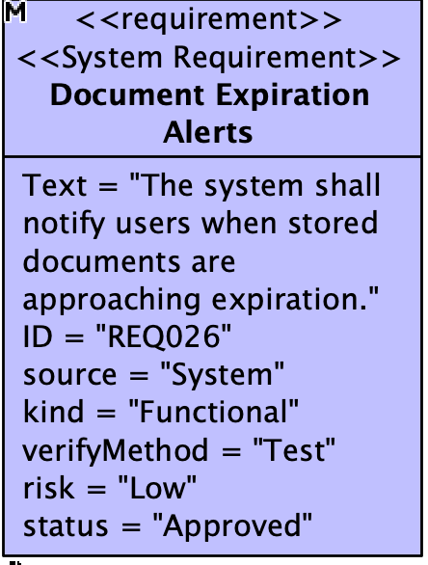
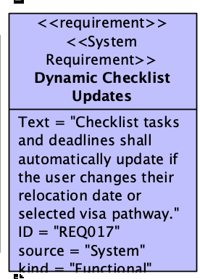
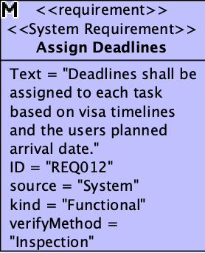
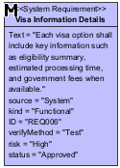
User/sYSTEM Requirements

Slide 4
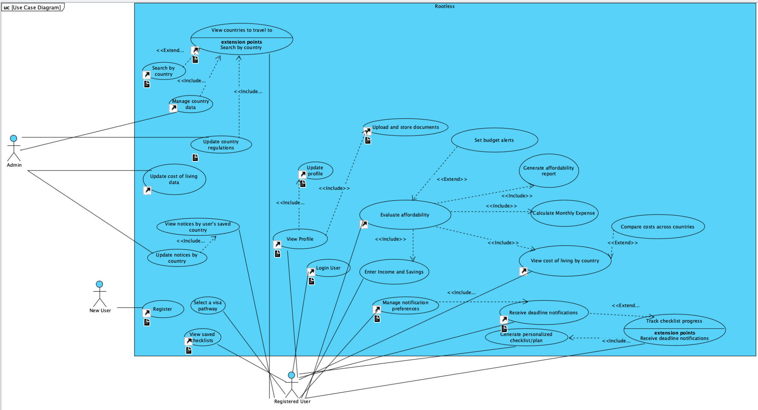
Use Case Diagram

Slide 5
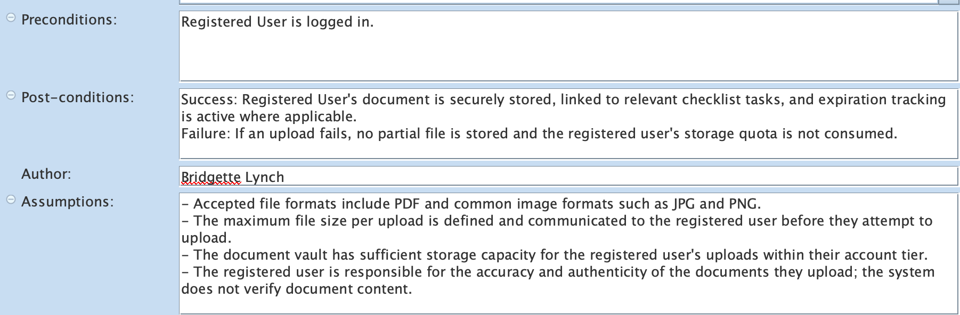
Use Case: Upload and Store Documents
Description: A logged-in Registered User uploads documents to their secure document vault, assigns each a document type, optionally records an expiration date, and links the document to relevant checklist tasks. The system encrypts and stores the file.
Specification Elements:

Slide 6
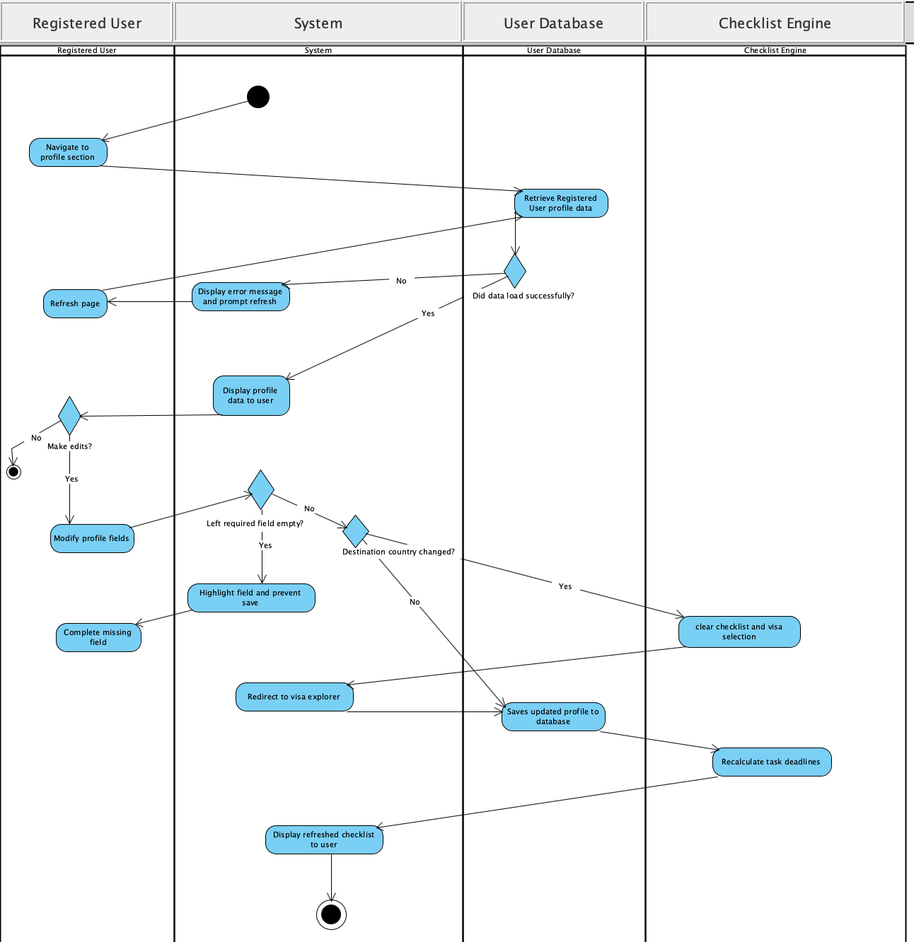
Use Case: Upload and Store Documents
Activity Diagram:

Slide 7
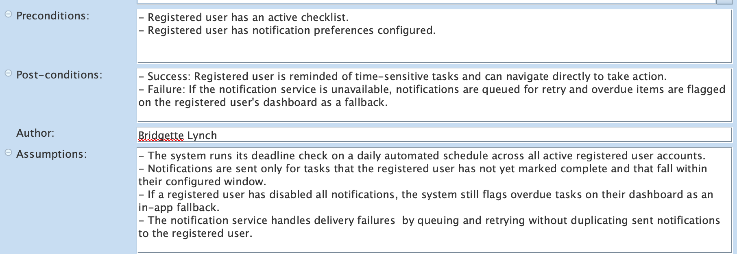
Use Case: Receive Deadline Notifications
Description: The system identifies upcoming task deadlines and expiring documents within each registered user's configured notification window and sends reminders through the method the registered user chose. This use case includes Manage Notification Preferences and extends Track Checklist Progress.
Specification Elements:

Slide 8
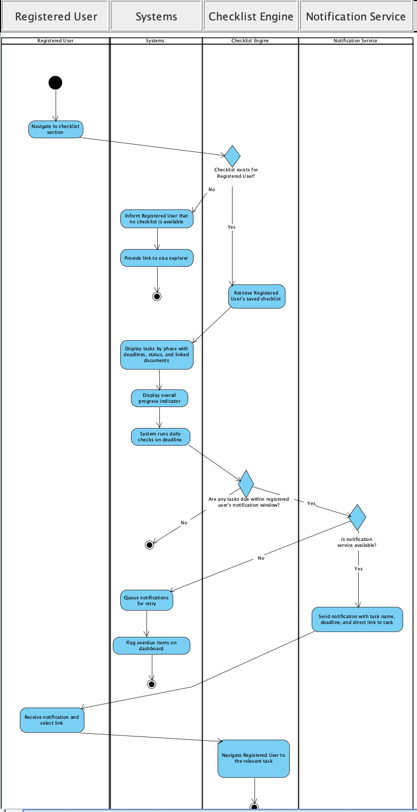
Use Case: Upload and Store Documents
Activity Diagram:

Slide 9
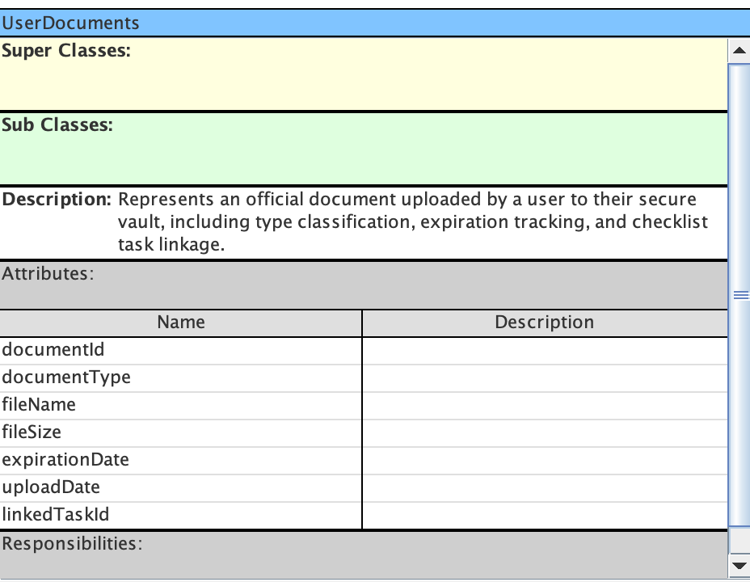
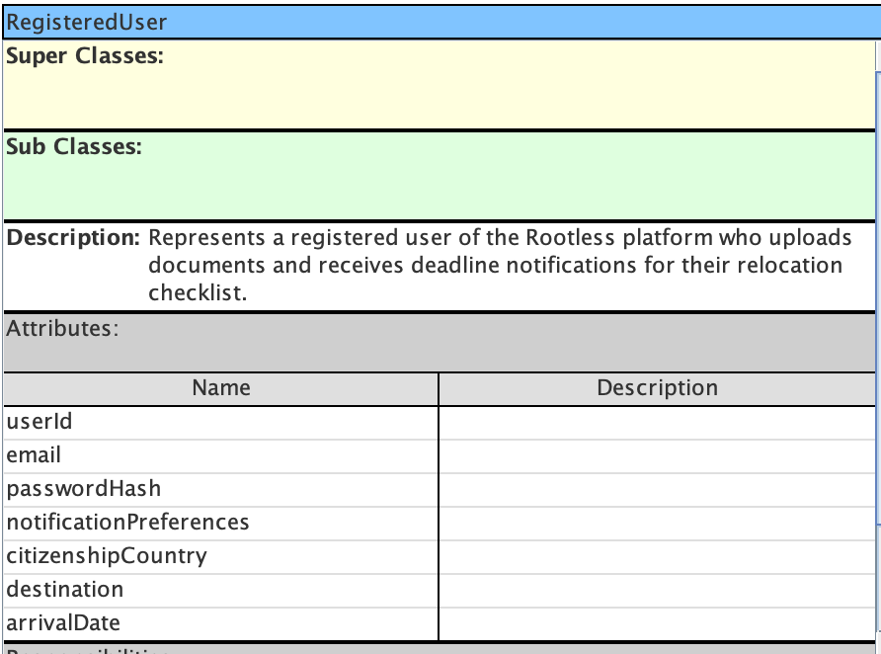
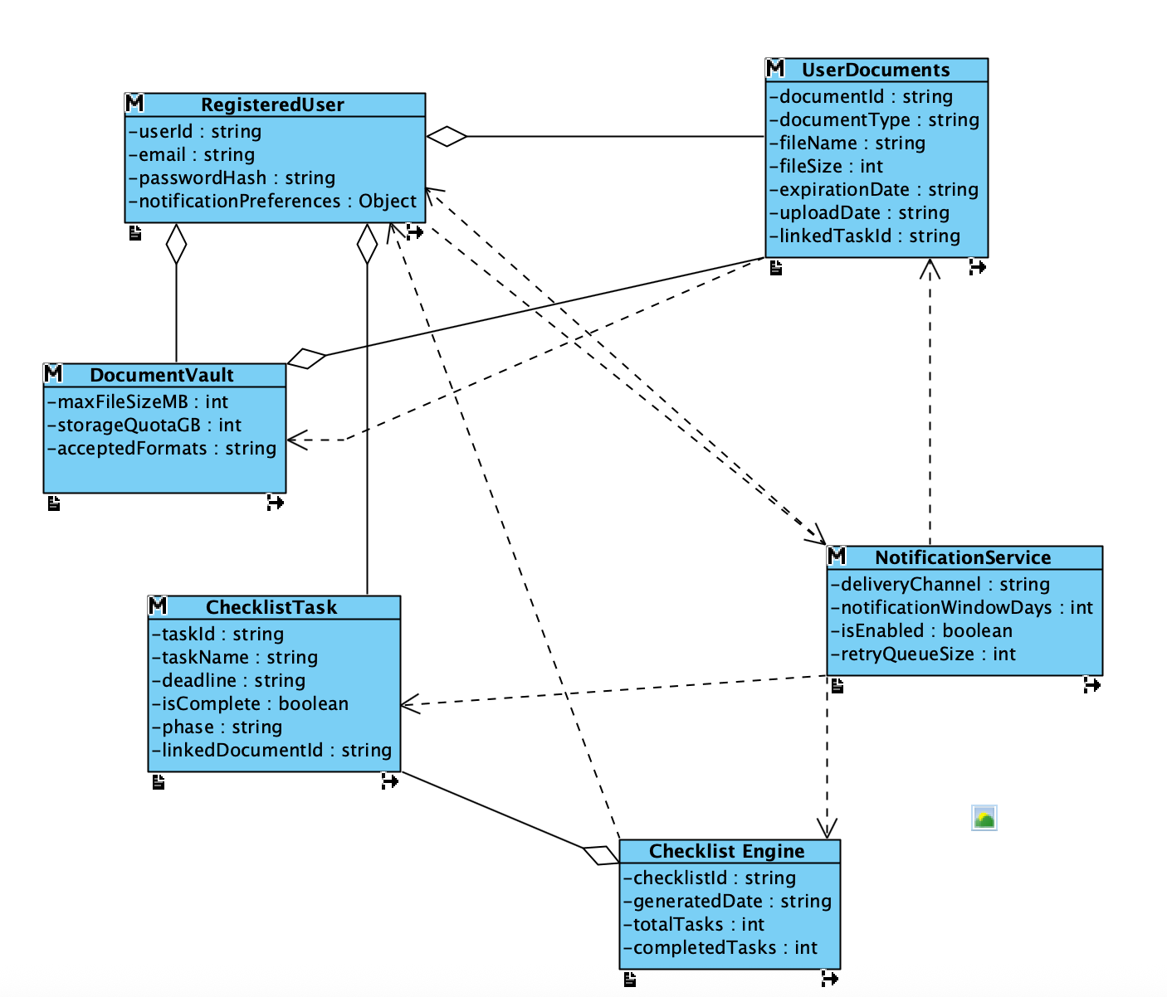
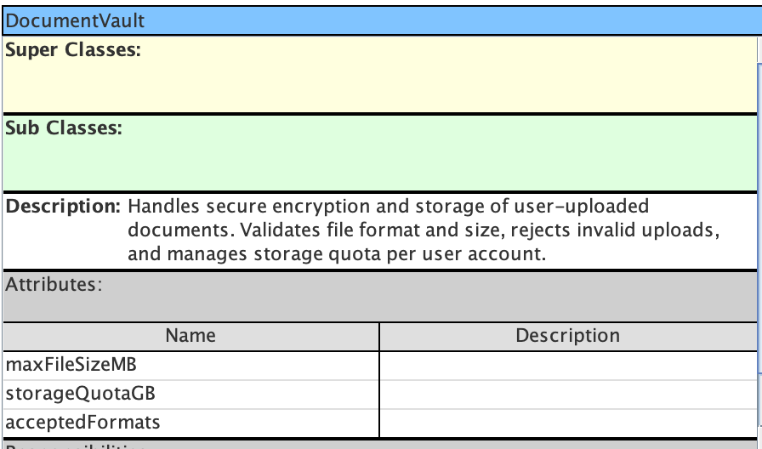
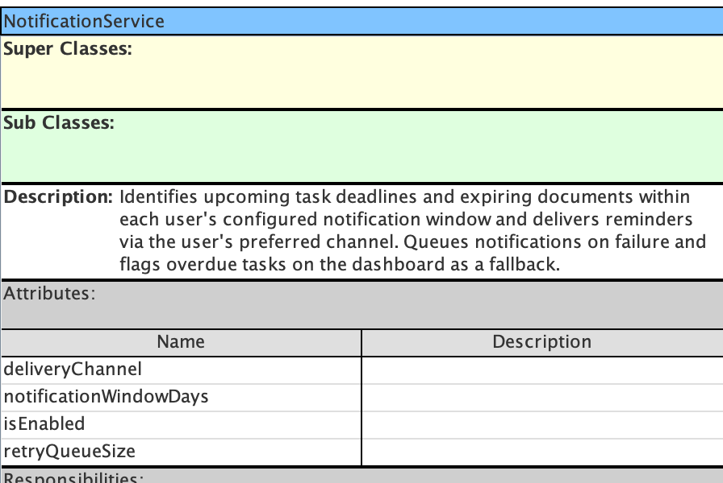
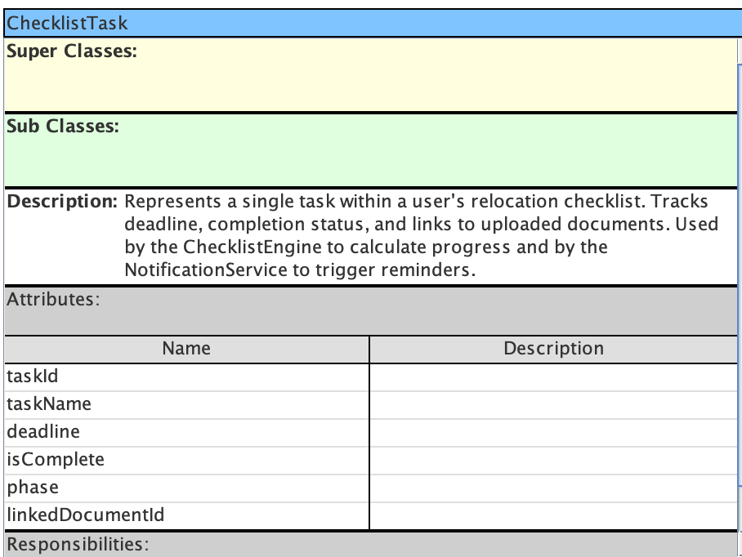
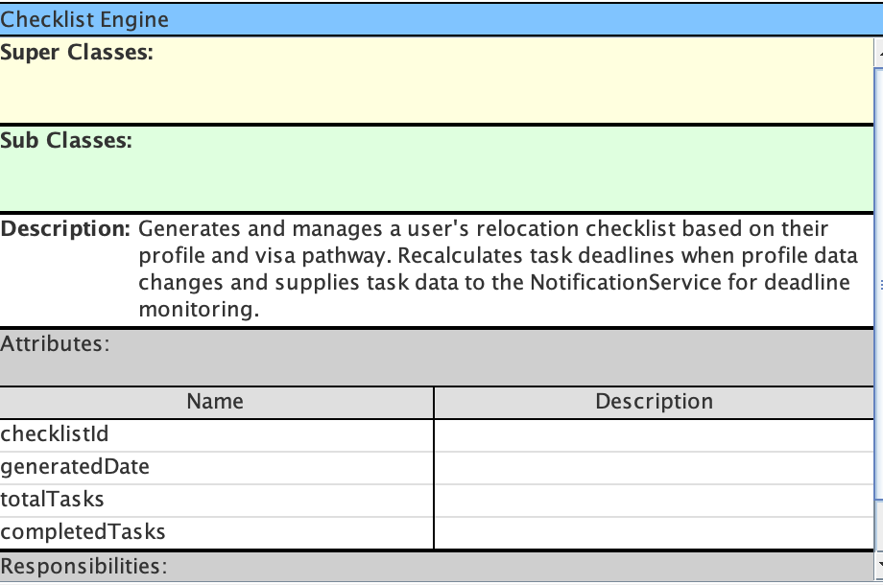
uPLOAD & STORE DOCUMENTS AND receive deadline notifications
CRC Cards and Class Diagram:

Slide 10
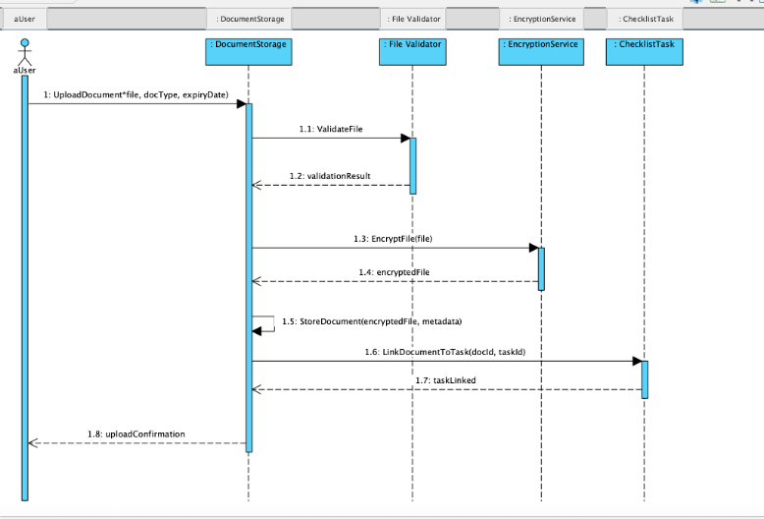
Use Case: Upload and Store Documents
Sequence Diagram:

Slide 11
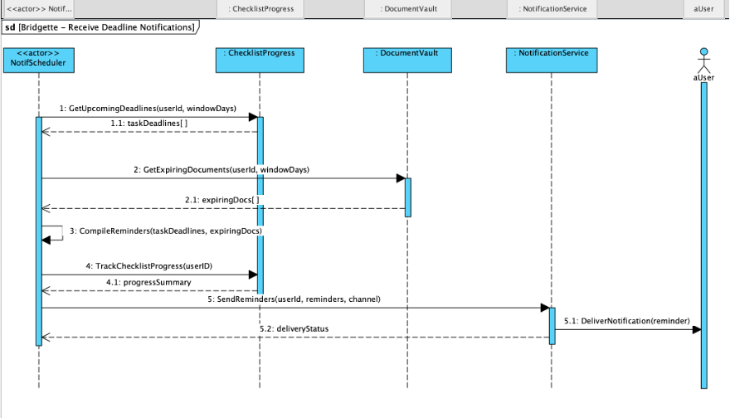
Use Case: receive deadline notifications
Sequence Diagram:

Slide 12
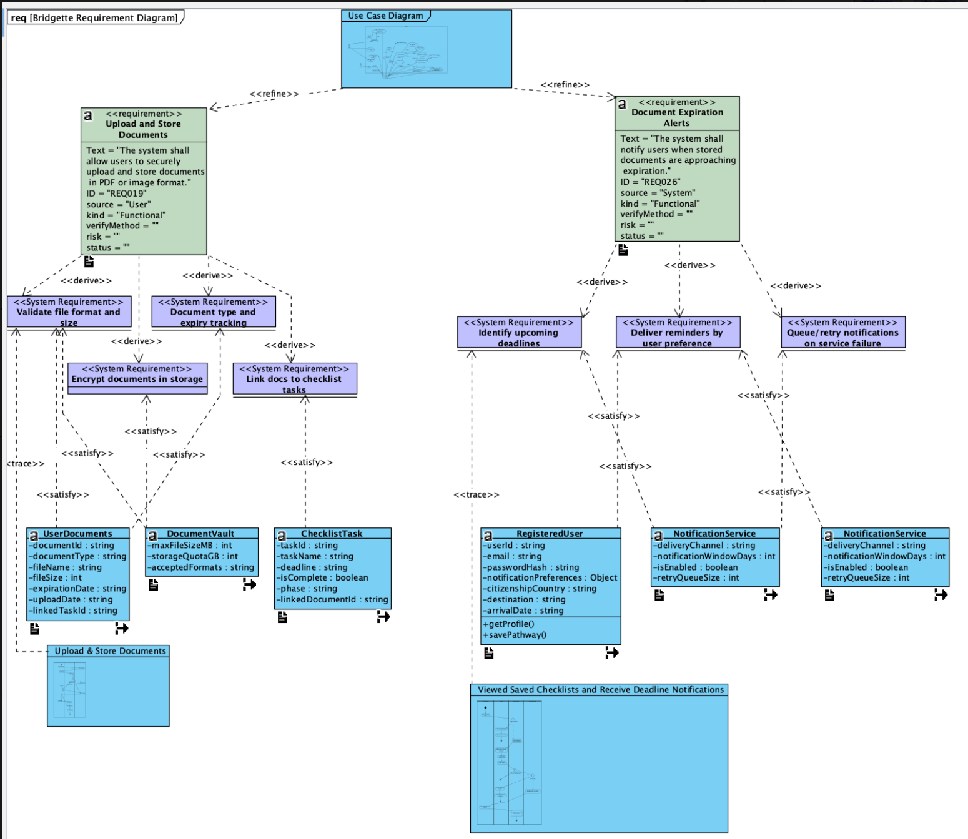
uPLOAD & STORE DOCUMENTS AND receive deadline notifications
Requirement Diagram:

Slide 13
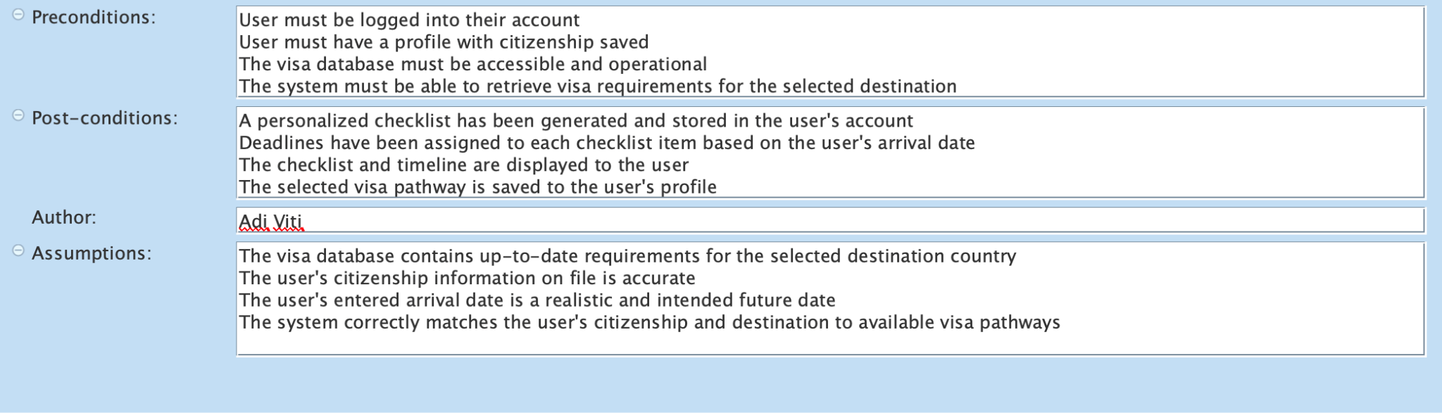
Use CASE: Generate personalized plan FOR SELECTED COUNTRY & VISA
Notes:
Adi

Slide 14
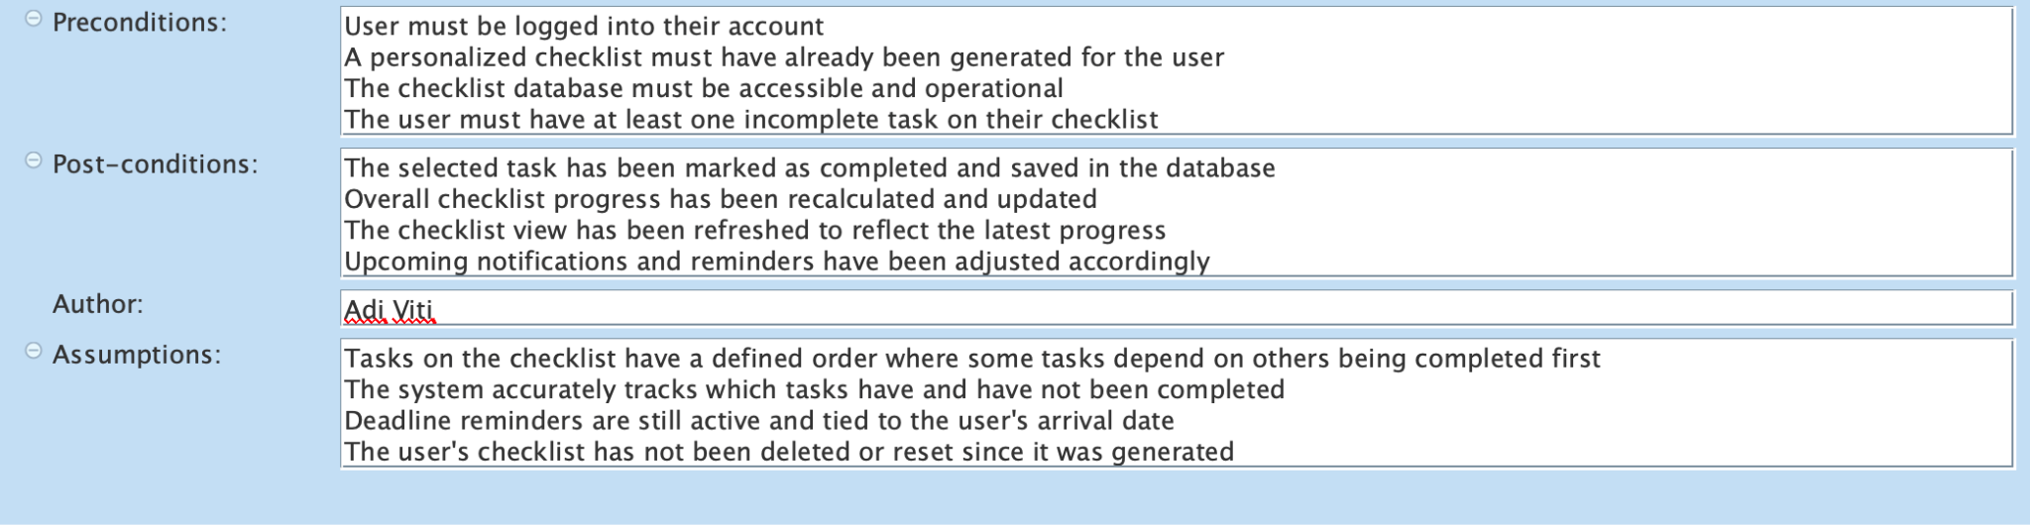
Use CASE: Track checklist progress

Slide 15
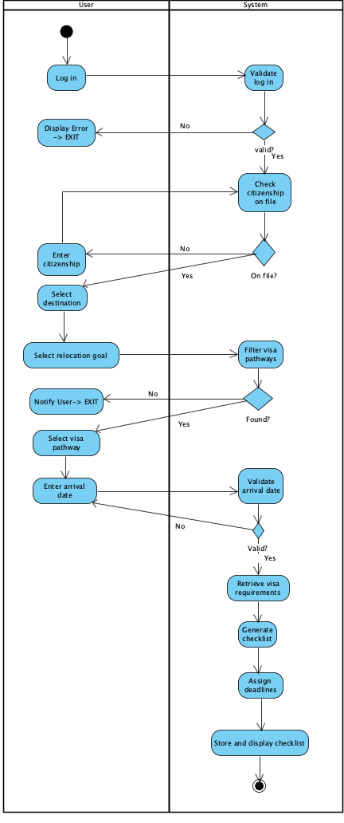
Use CASE: Generate personalized plan FOR SELECTED COUNTRY & VISA
Activity Diagram:

Slide 16
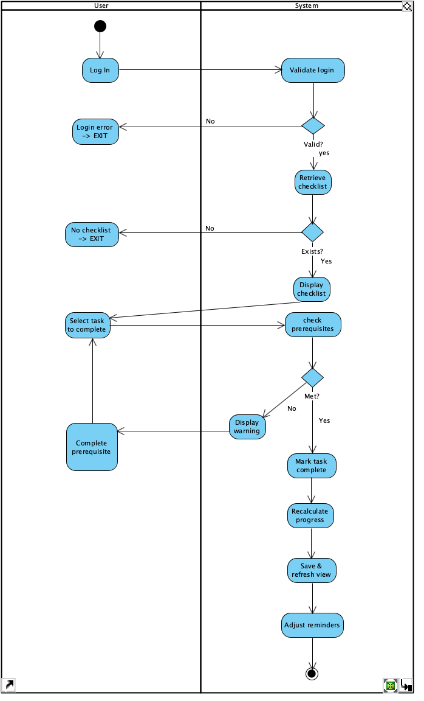
Use CASE: Track checklist progress
Activity Diagram:

Slide 17
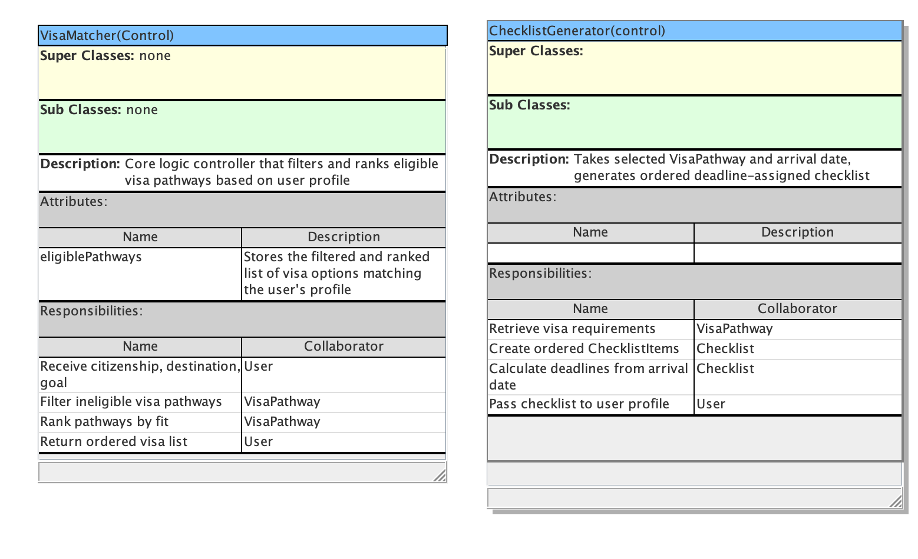
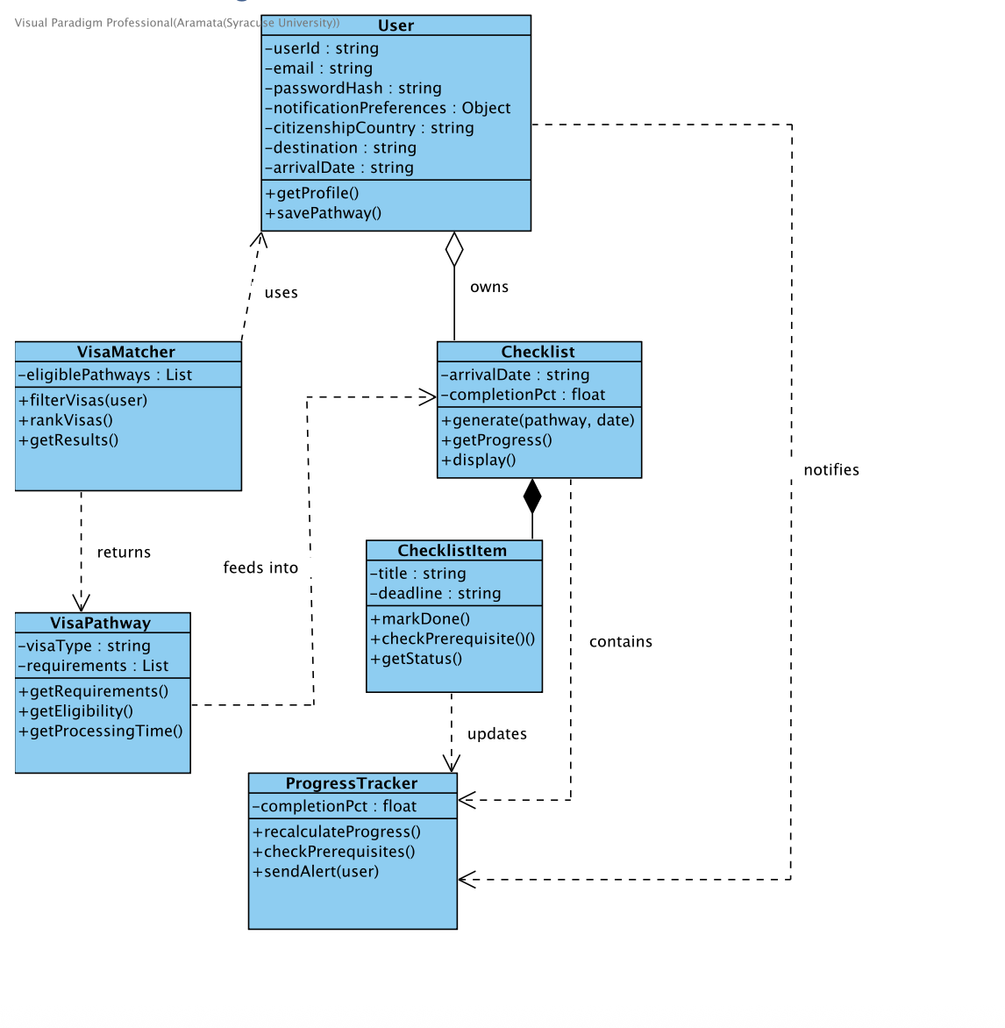
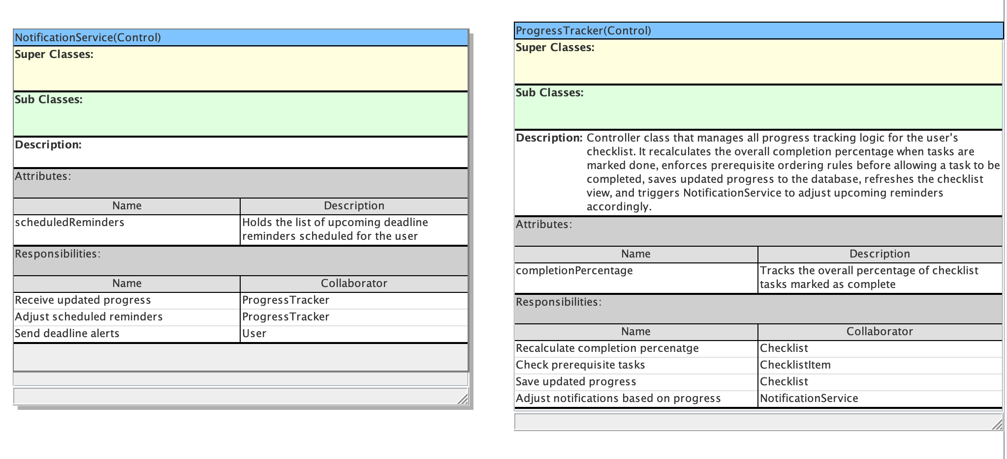
Both Use Cases Regarding cHECKLIST
CRC Cards and Class Diagram:

Slide 18
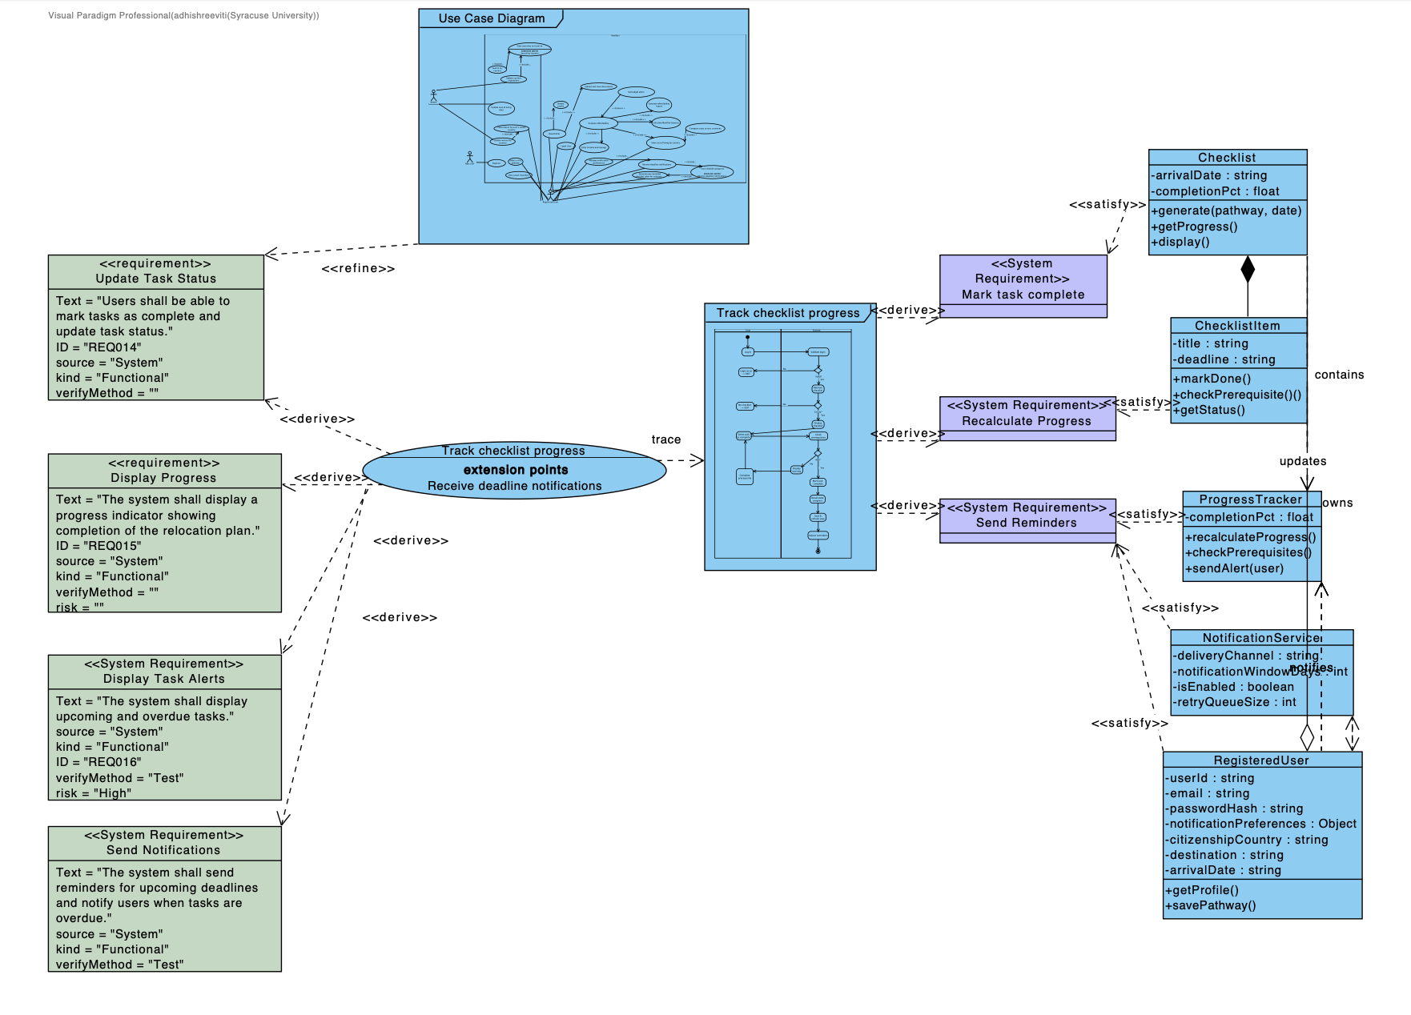
Both Use Cases Regarding cHECKLIST
Mappings:

Slide 19
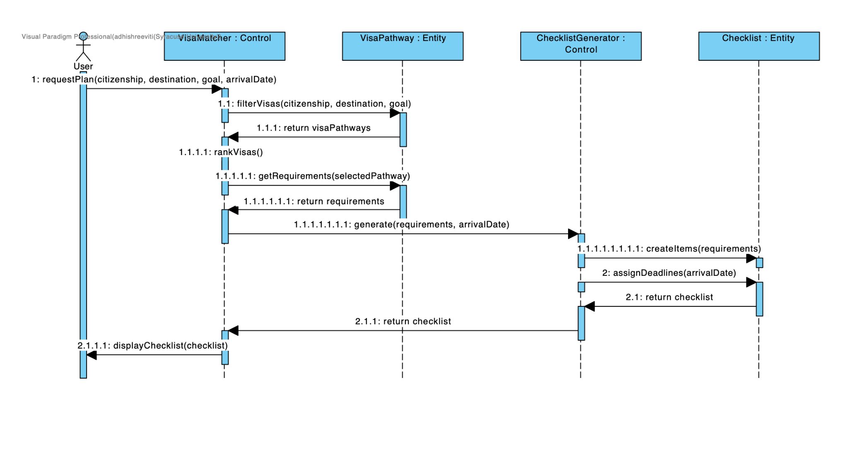
Both Use Cases Regarding cHECKLIST
Sequence Diagram:

Slide 20
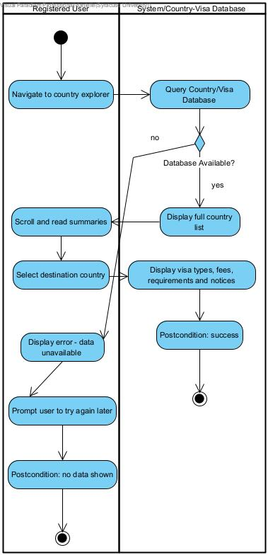
View Countries to Travel to

Slide 21
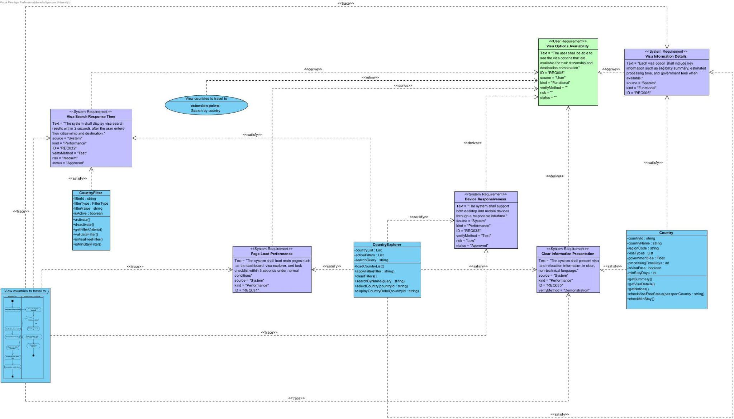
View Countries to Travel to

Slide 22
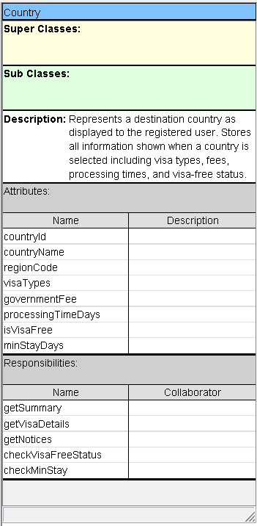
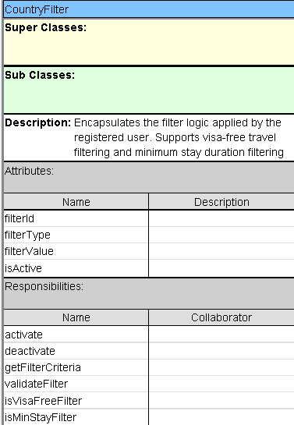
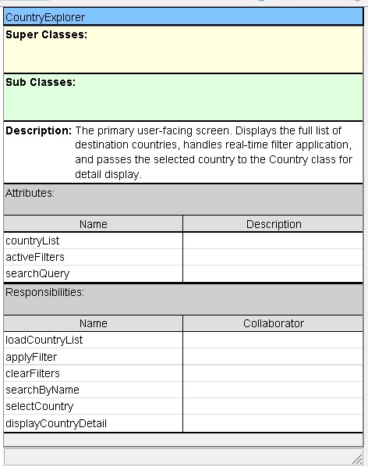
View Countries to Travel to

Slide 23
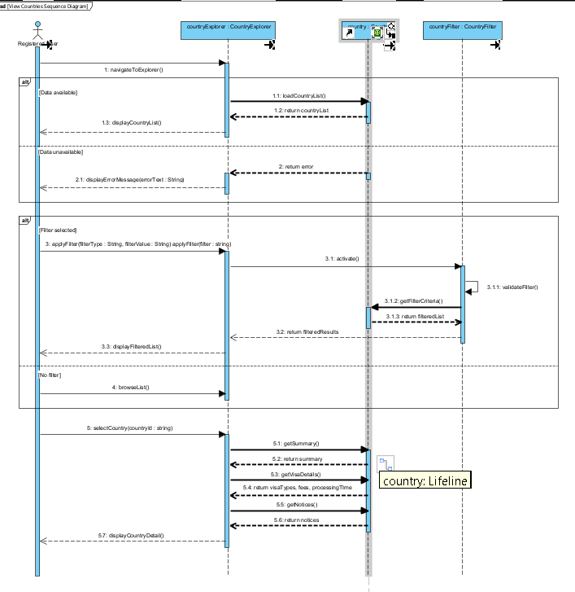
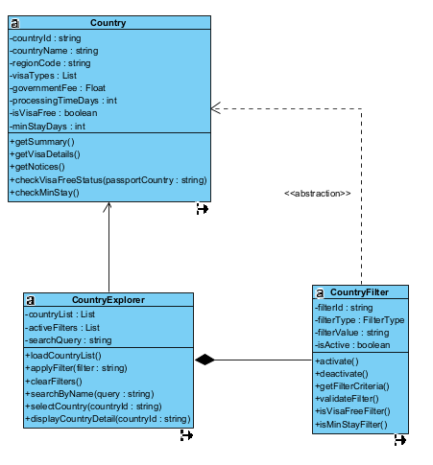
View Countries to Travel to

Slide 24
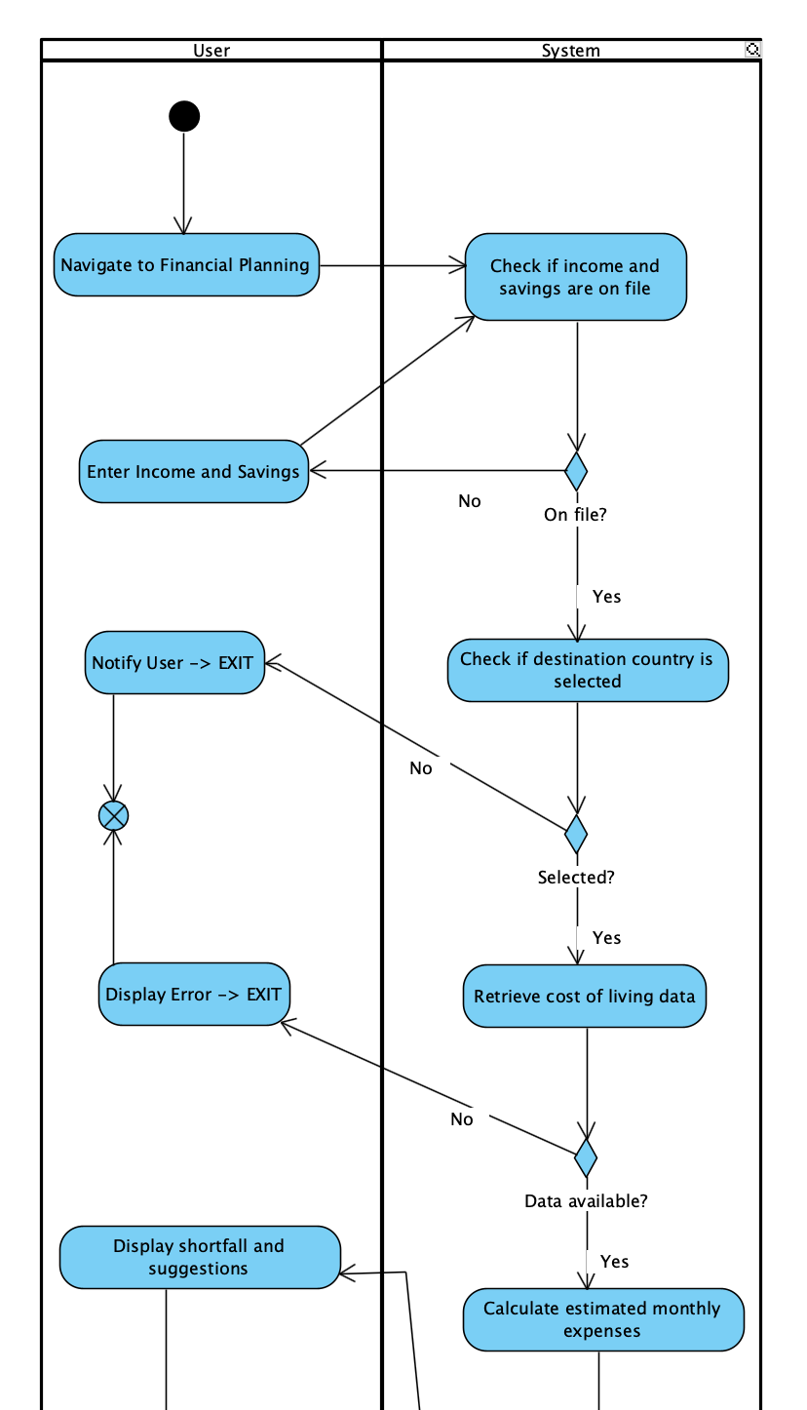
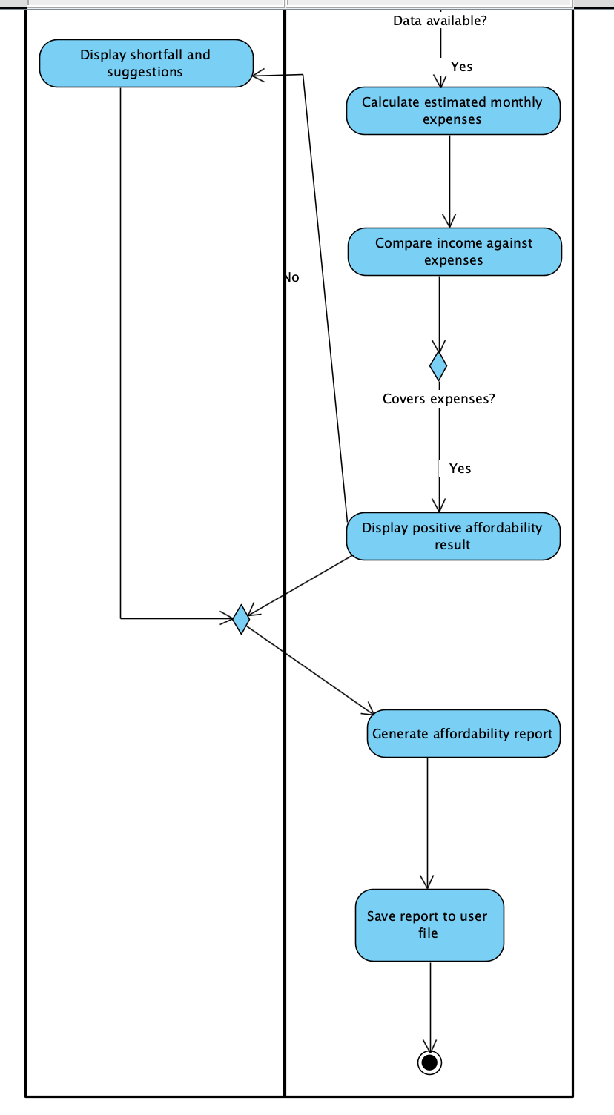
Evaluate Affordability

Slide 25
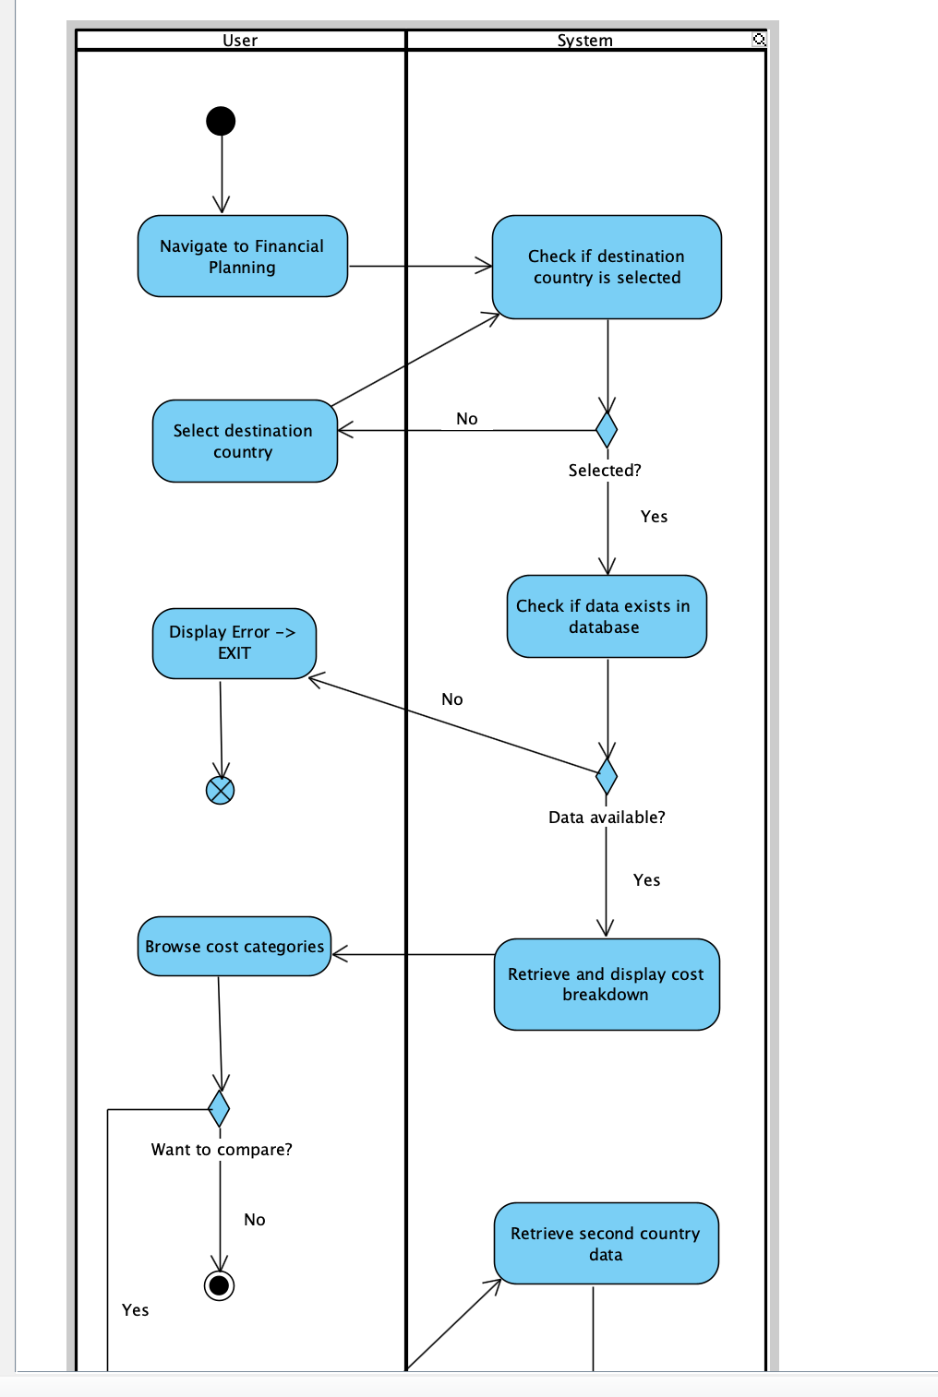
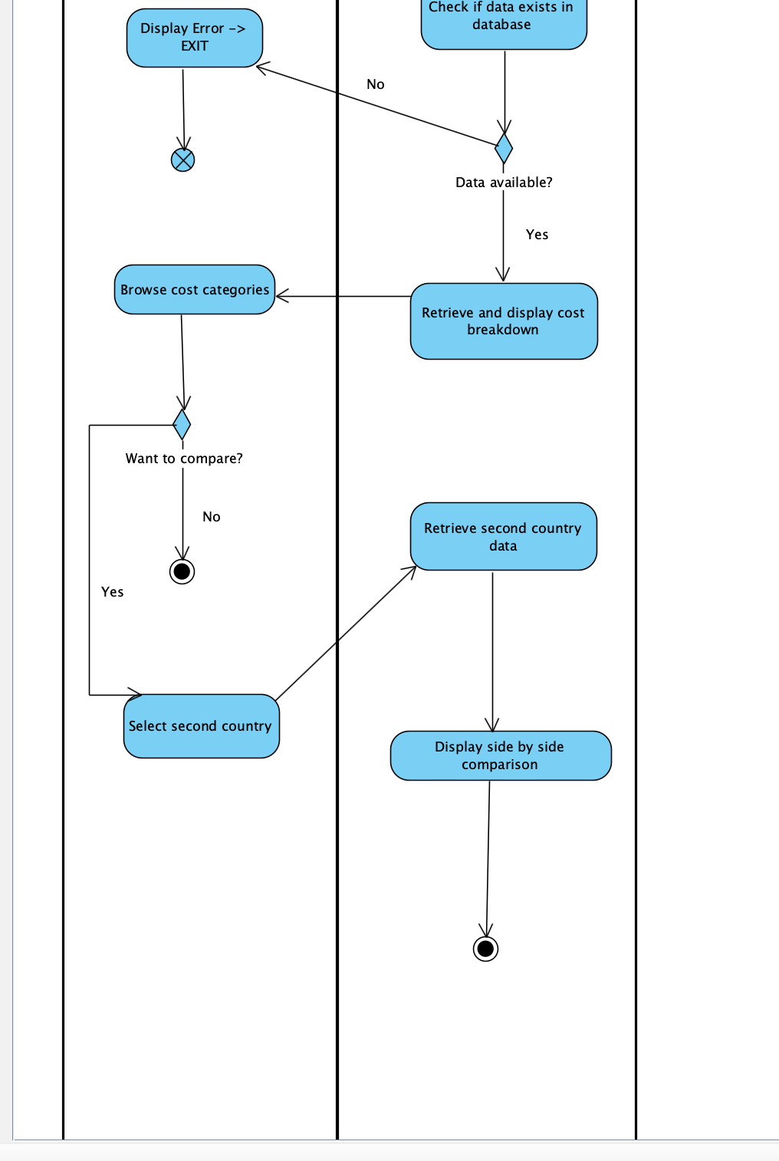
View Cost of Living by Country

Slide 26
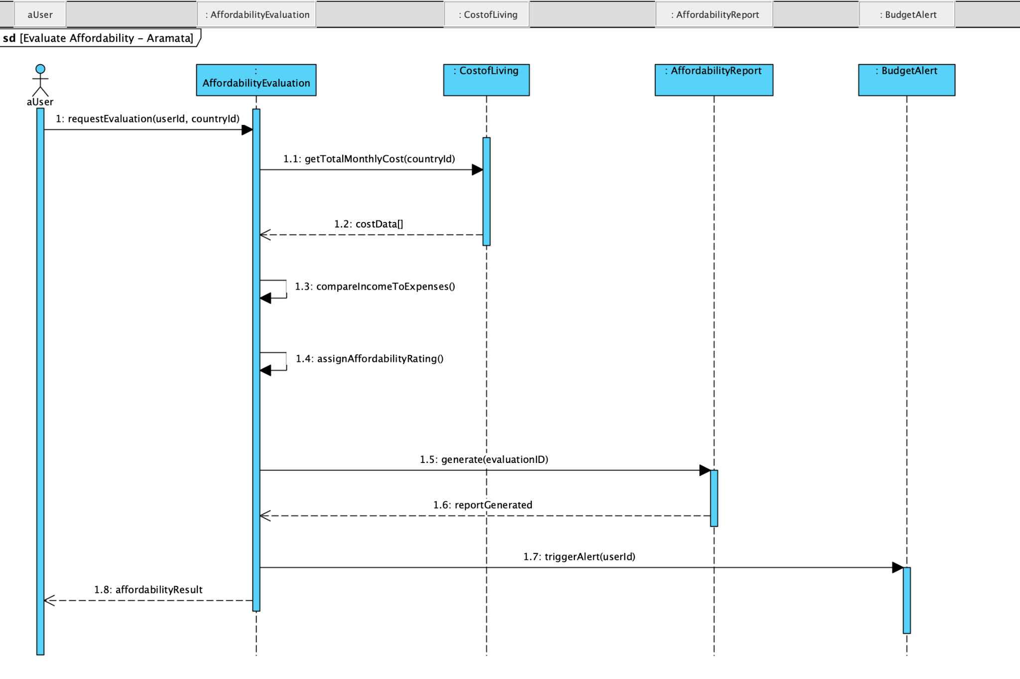
Evaluate AffordAbility

Slide 27
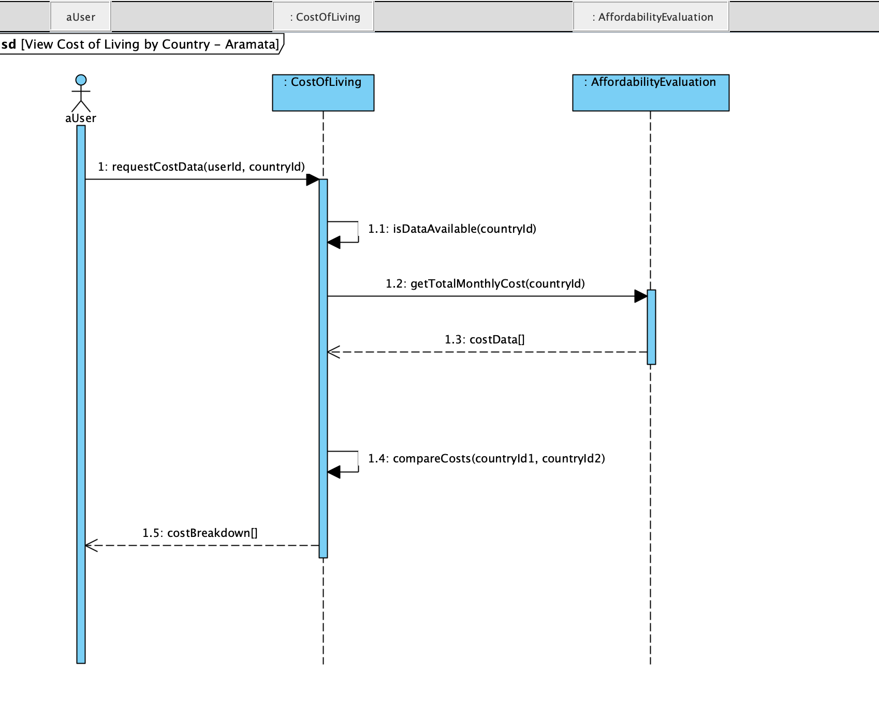
View Cost of Living by Country

Slide 28
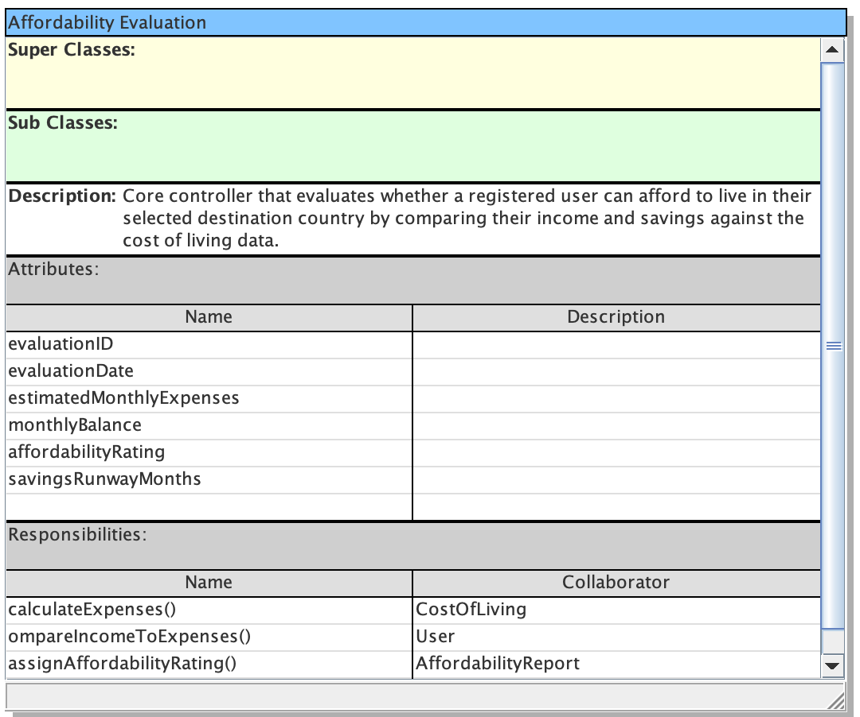
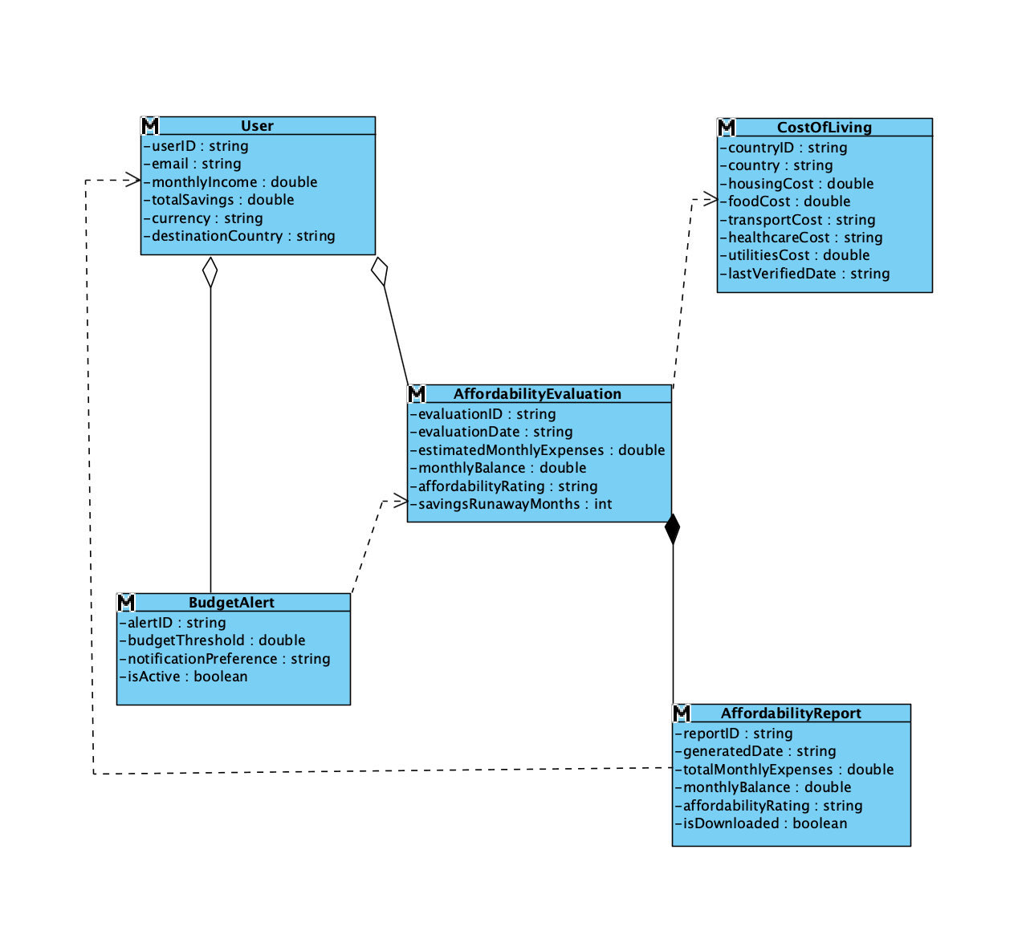
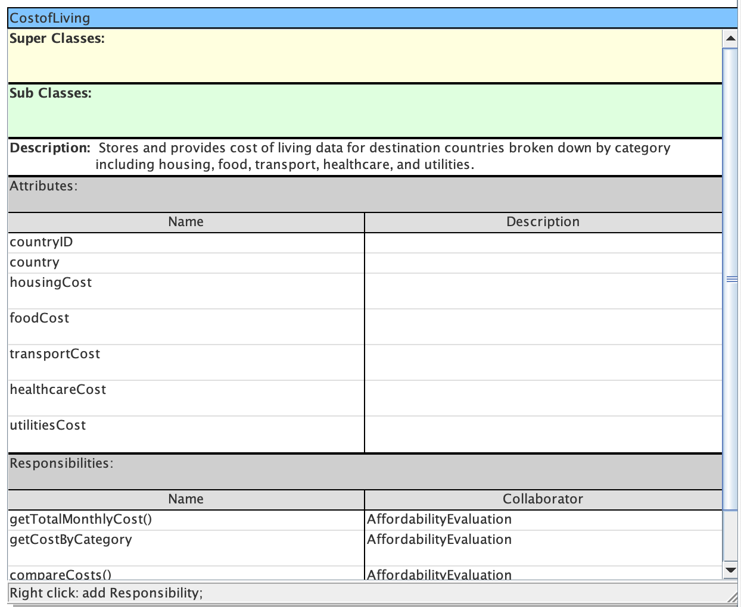
Class Diagrams and CRC Cards

Slide 29
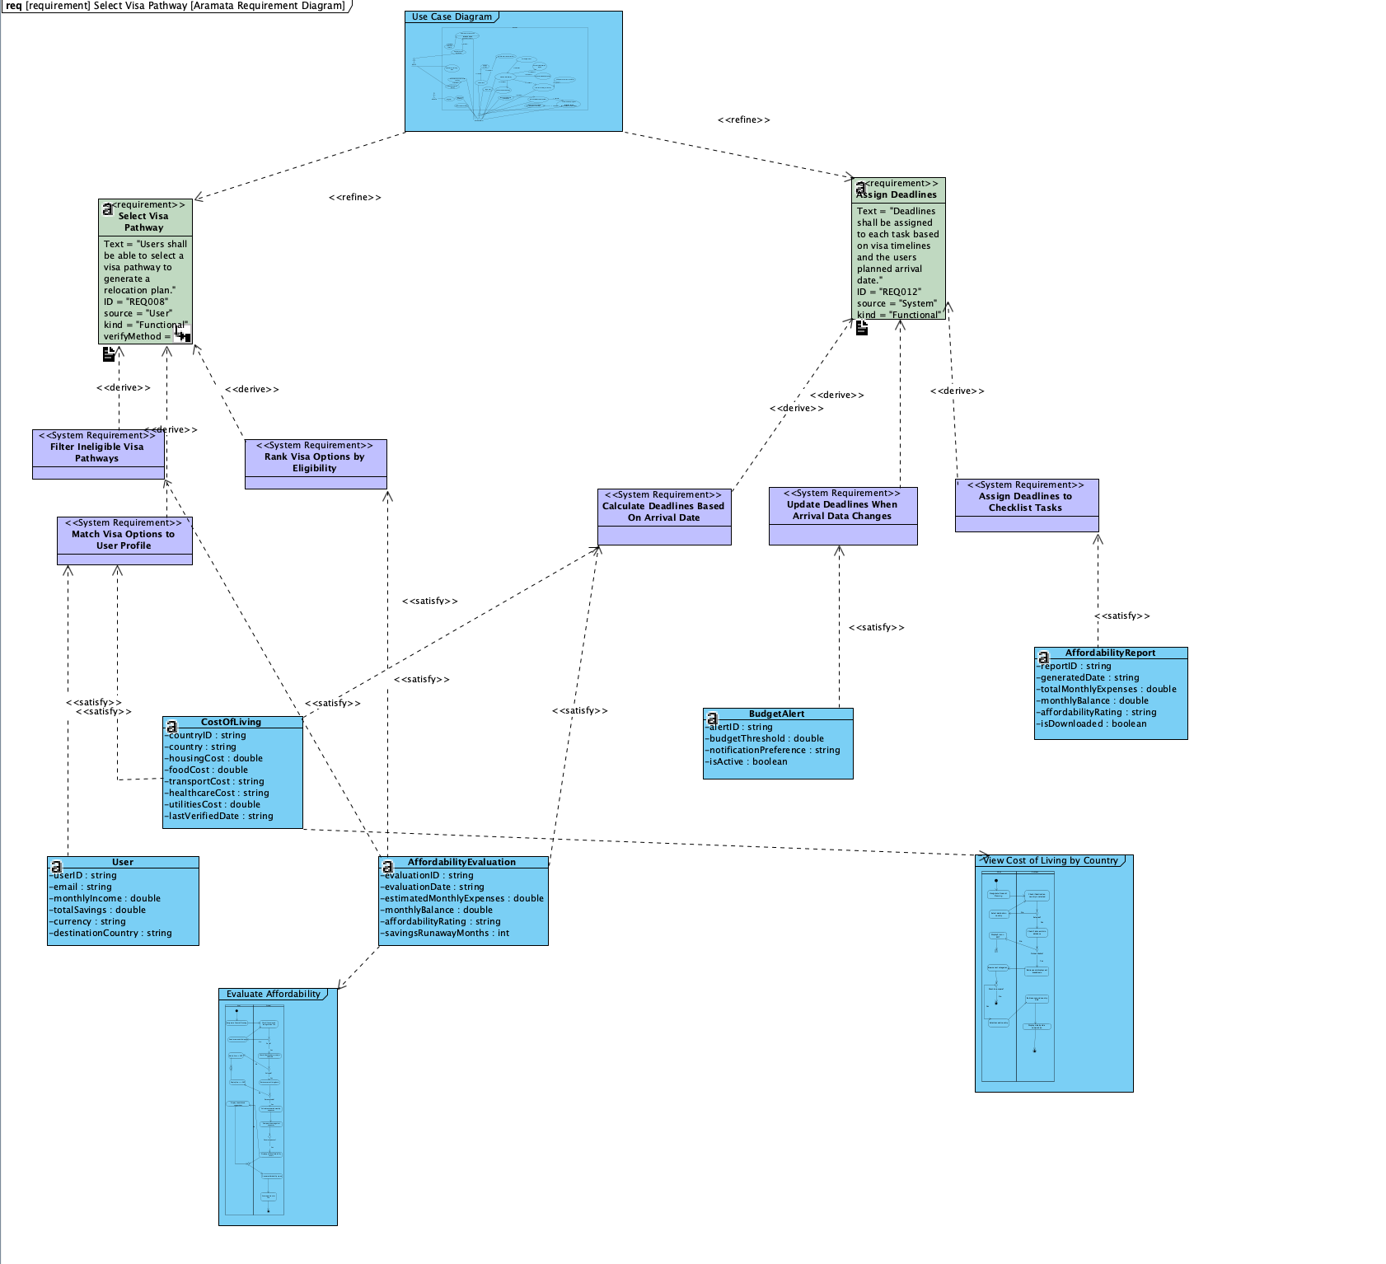
Requirement Diagram

Slide 30
Thank you!

